Slide 1
Heaps

Slide 2
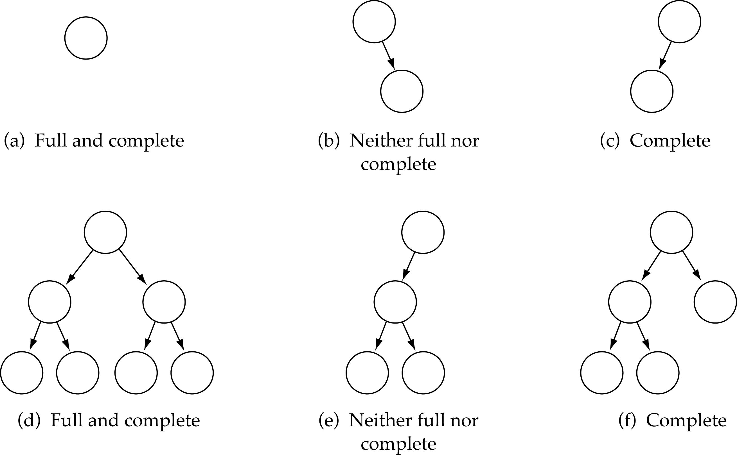
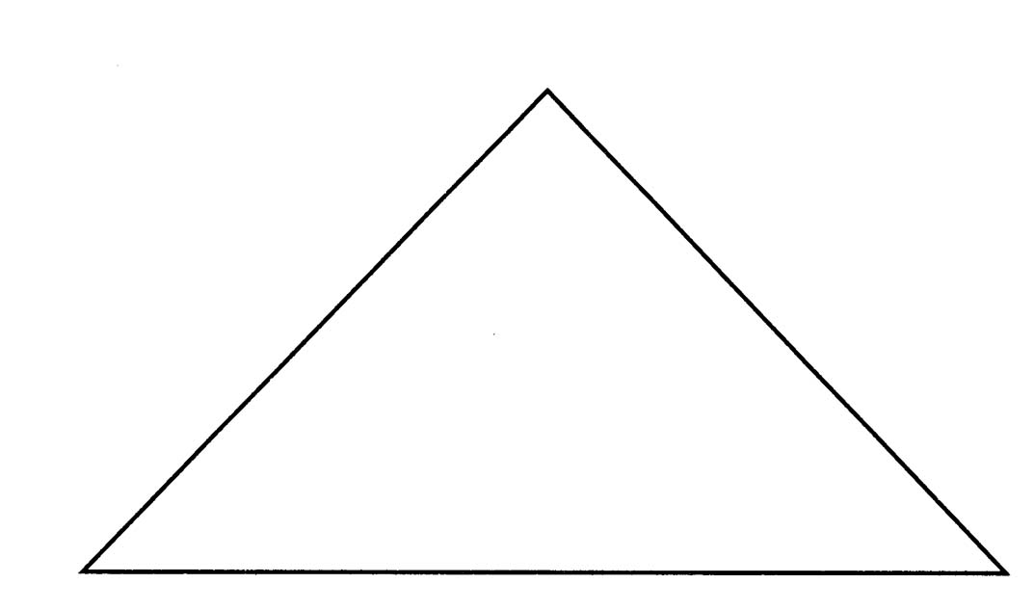
Full Binary Tree
Every non-leaf node has two children
All the leaves are on the same level
Full Binary Tree

Slide 3
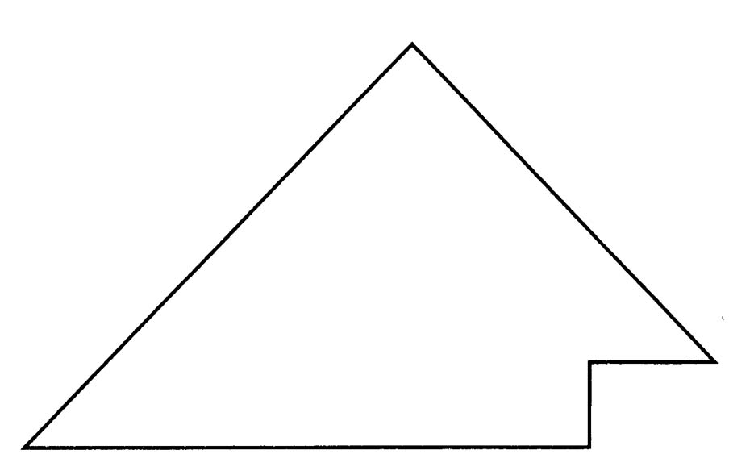
Complete Binary Tree
A binary tree that is either full or full through the next-to-last level
The last level is full from left to right (i.e., leaves are as far to the left as possible)
Complete Binary Tree

Slide 4
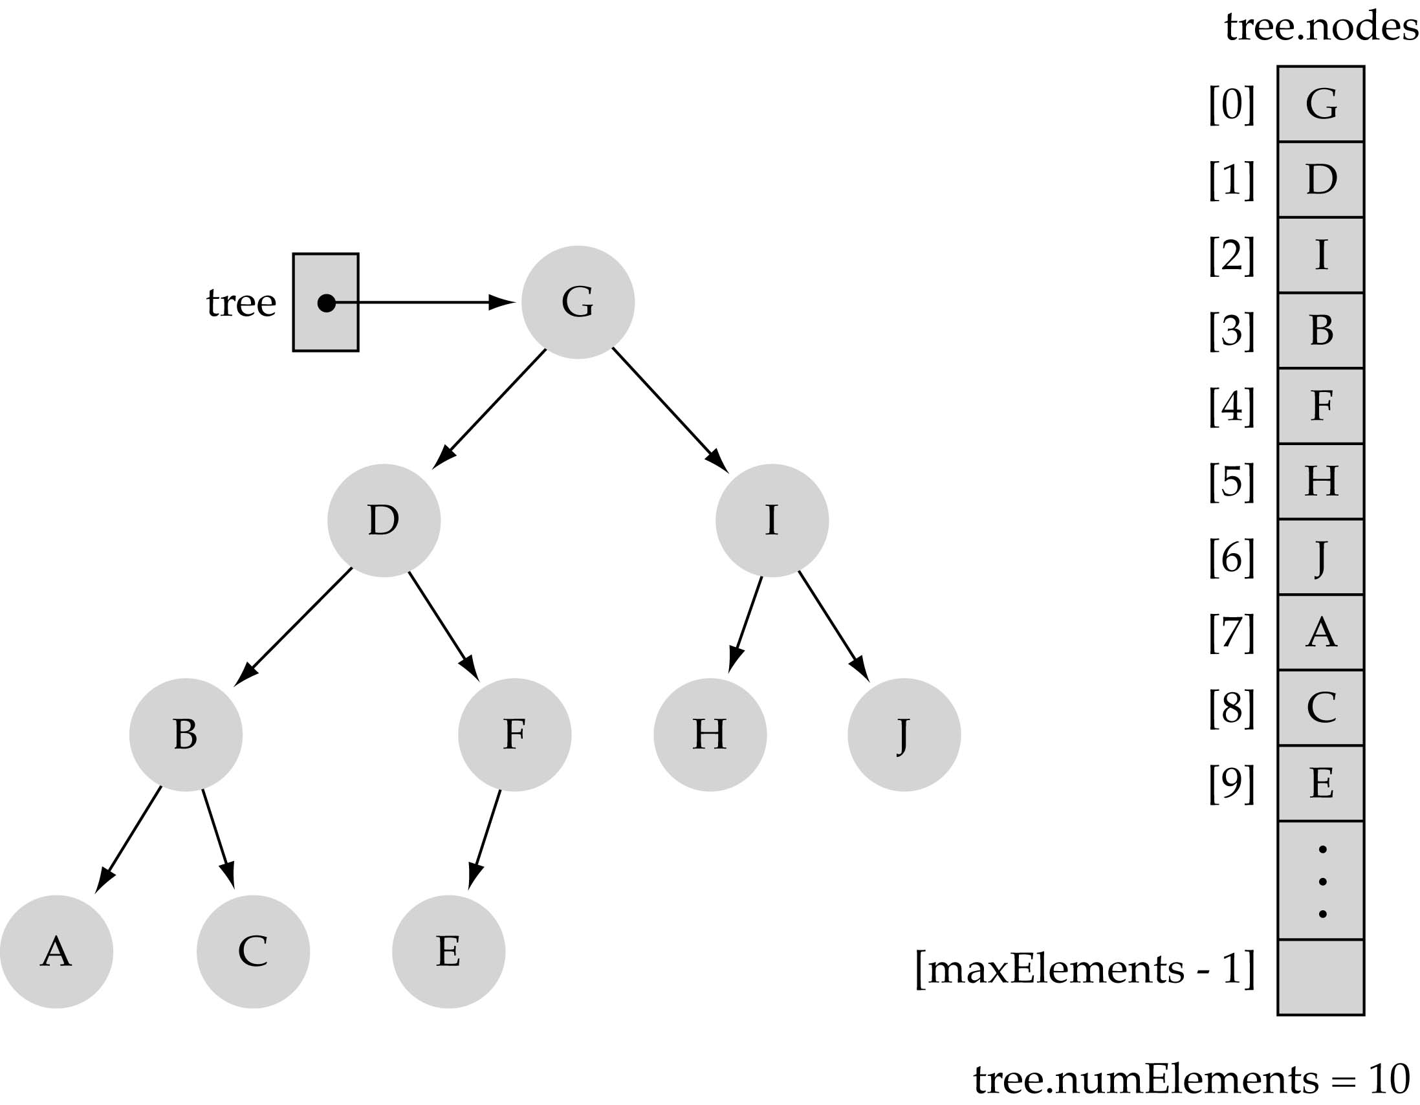
Array-based representation of binary trees
Memory space can be saved (no pointers are required)
Preserve parent-child relationships by storing the tree elements in the array
(i) level by level, and (ii) left to right
0
1
2
4
5
6
3
7
8
9

Slide 5
Array-based representation of binary trees (cont.)
Parent-child relationships:
  left child of tree.nodes[index] = tree.nodes[2*index+1]
  right child of tree.nodes[index] = tree.nodes[2*index+2]
  parent node of tree.nodes[index] = tree.nodes[(index-1)/2] (int division-truncate)
Leaf nodes:
  tree.nodes[numElements/2] to tree.nodes[numElements - 1]
(int division-truncate)

Slide 6
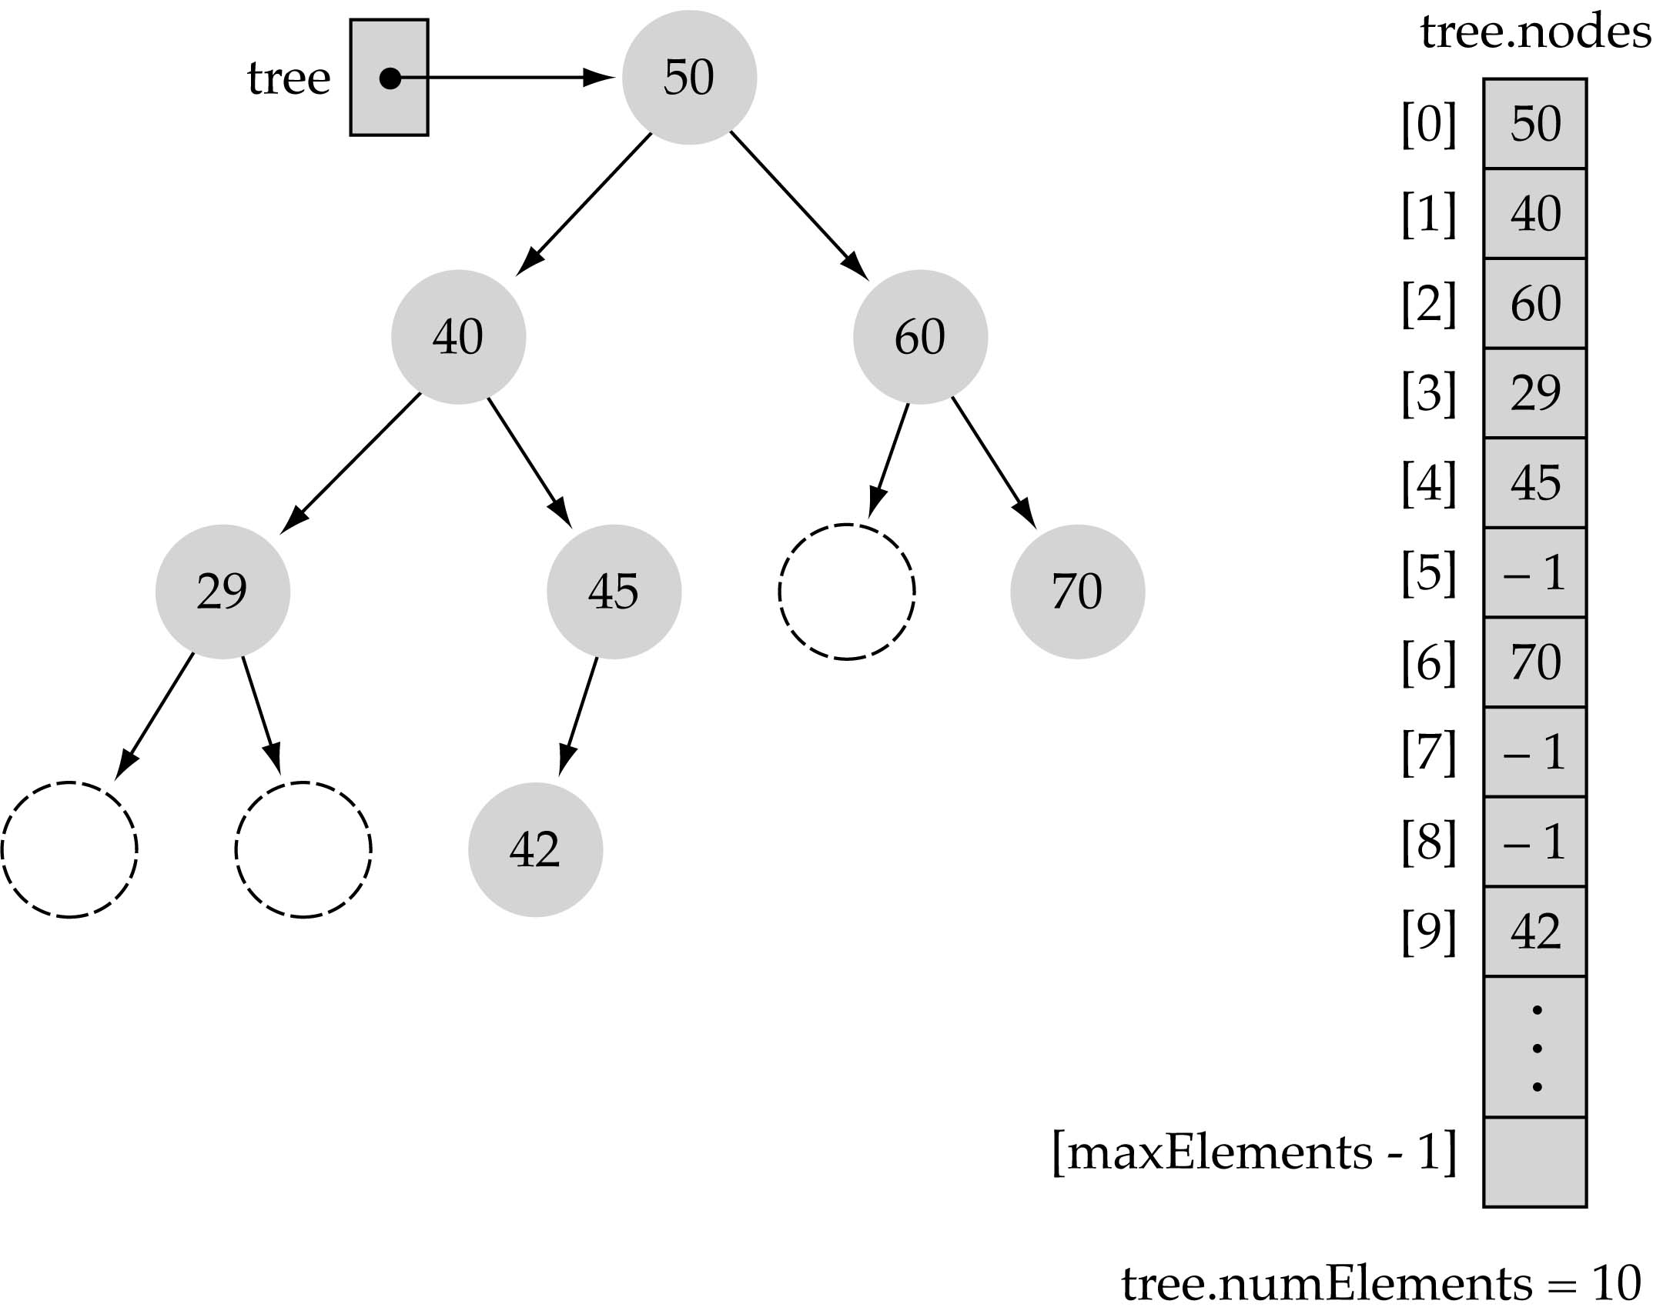
Array-based representation of binary trees (cont.)
Full or complete trees can be implemented easily using an array-based representation (elements occupy contiguous array slots)
"Dummy nodes" are required for trees which are not full or complete

Slide 7
What is a heap?
It is a binary tree with the following properties:
  Property 1: it is a complete binary tree
  Property 2: the value stored at a node is greater or equal to the values stored at the children (heap property)

Slide 8
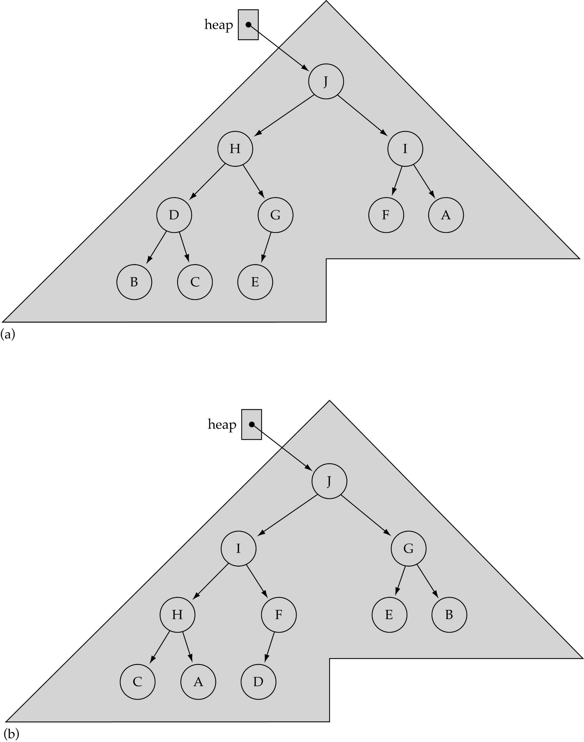
What is a heap? (cont.)

Slide 9
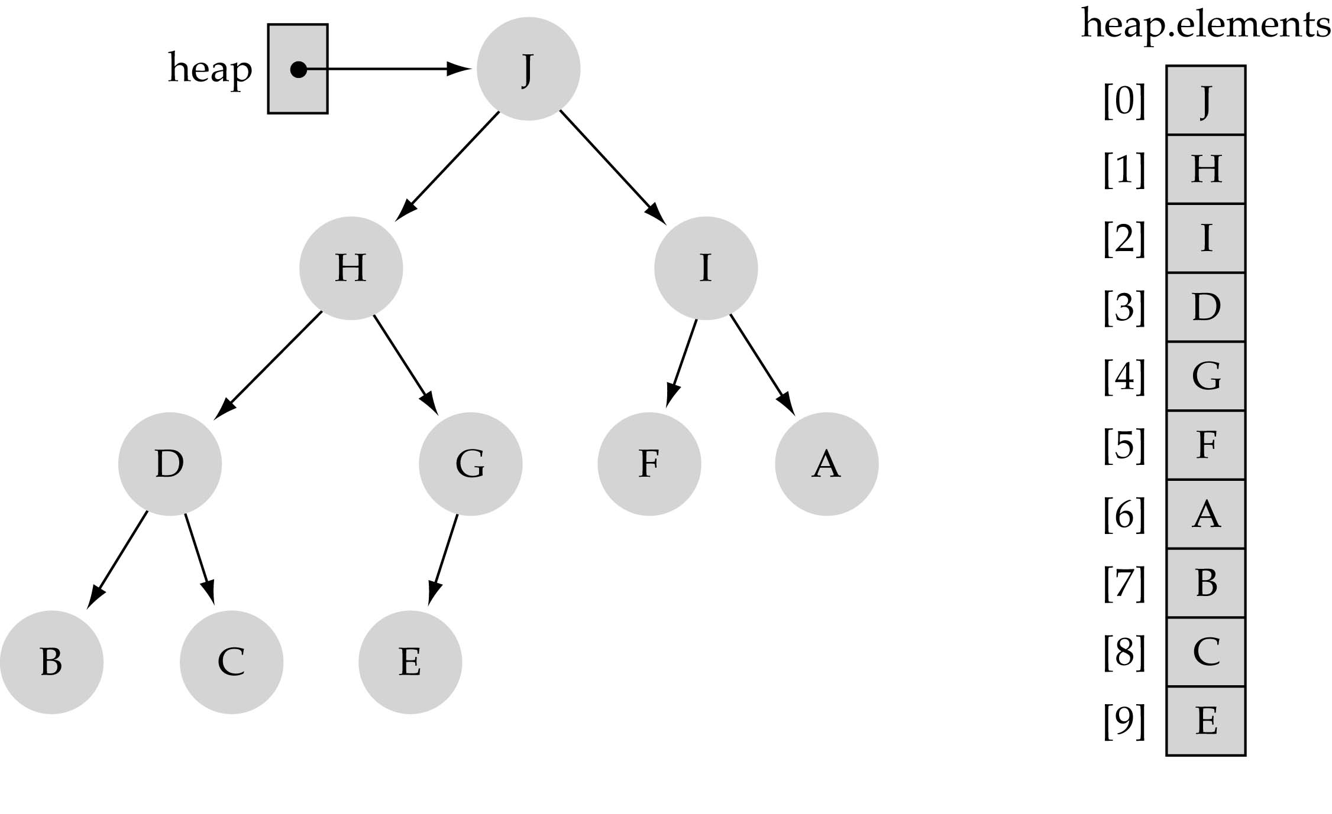
Largest heap element
From Property 2, the largest value of the heap is always stored at the root

Slide 10
Heap implementation using array representation
A heap is a complete binary tree, so it is easy to be implemented using an array representation

Slide 11
Heap Specification
template<class ItemType>
struct HeapType {
void ReheapDown(int, int);
void ReheapUp(int, int);
ItemType *elements;
int numElements; // heap elements
};

Slide 12
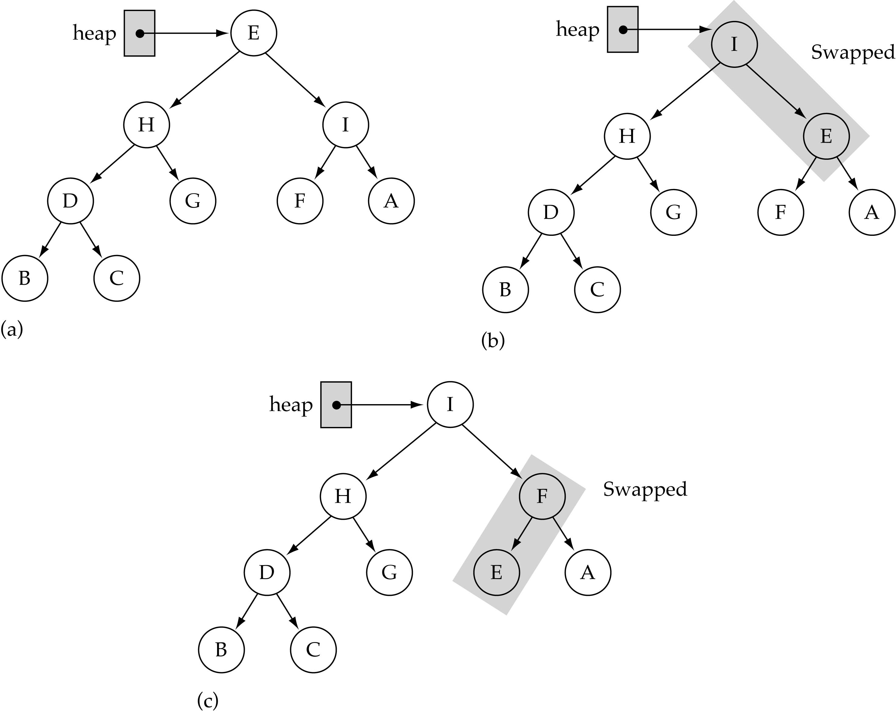
The ReheapDown function
(used by deleteItem)
Assumption:
heap property is
violated at the
root of the tree

Slide 13
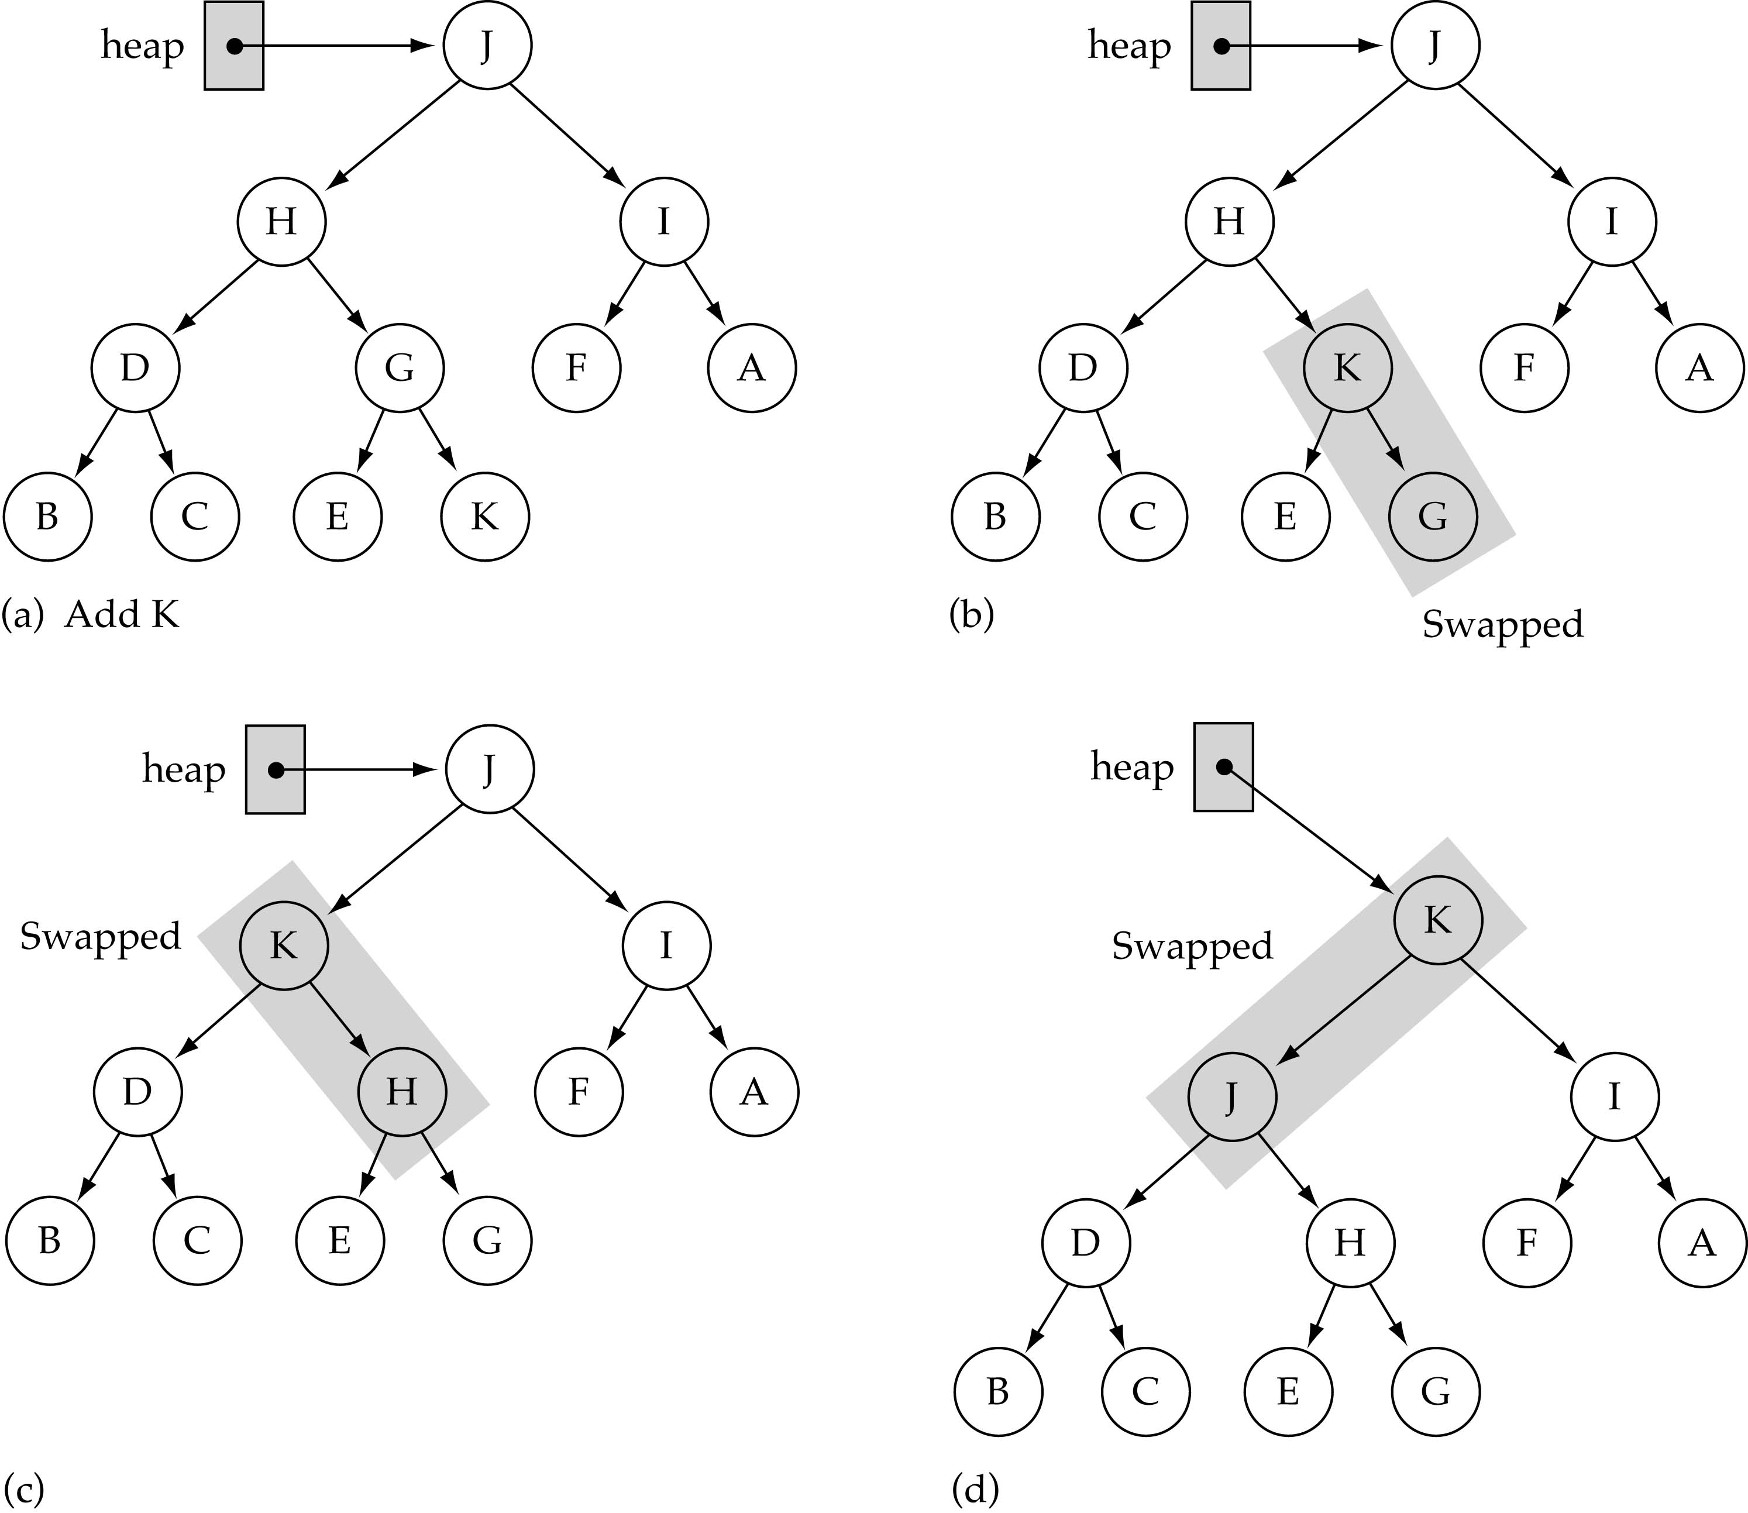
The ReheapUp function
(used by insertItem)
bottom
Assumption:
heap property is
violated at the
rightmost node
at the last level
of the tree

Slide 14
ReheapDown function
rightmost node
in the last level
template<class ItemType>
void HeapType<ItemType>::ReheapDown(int root, int bottom)
{
int maxChild, rightChild, leftChild;
leftChild = 2*root+1;
rightChild = 2*root+2;
if(leftChild <= bottom) { // left child is part of the heap
if(leftChild == bottom) // only one child
maxChild = leftChild;
else {
if(elements[leftChild] <= elements[rightChild])
maxChild = rightChild;
else
maxChild = leftChild;
}
if(elements[root] < elements[maxChild]) {
Swap(elements, root, maxChild);
ReheapDown(maxChild, bottom);
}
}
}

Slide 15
ReheapUp function
Assumption:
heap property
is violated at bottom
template<class ItemType>
void HeapType<ItemType>::ReheapUp(int root, int bottom)
{
int parent;
if(bottom > root) { // tree is not empty
parent = (bottom-1)/2;
if(elements[parent] < elements[bottom]) {
Swap(elements, parent, bottom);
ReheapUp(root, parent);
}
}
}

Slide 16
Removing the largest element from the heap
(1) Copy the bottom rightmost element to the root
(2) Delete the bottom rightmost node
(3) Fix the heap property by calling ReheapDown

Slide 17
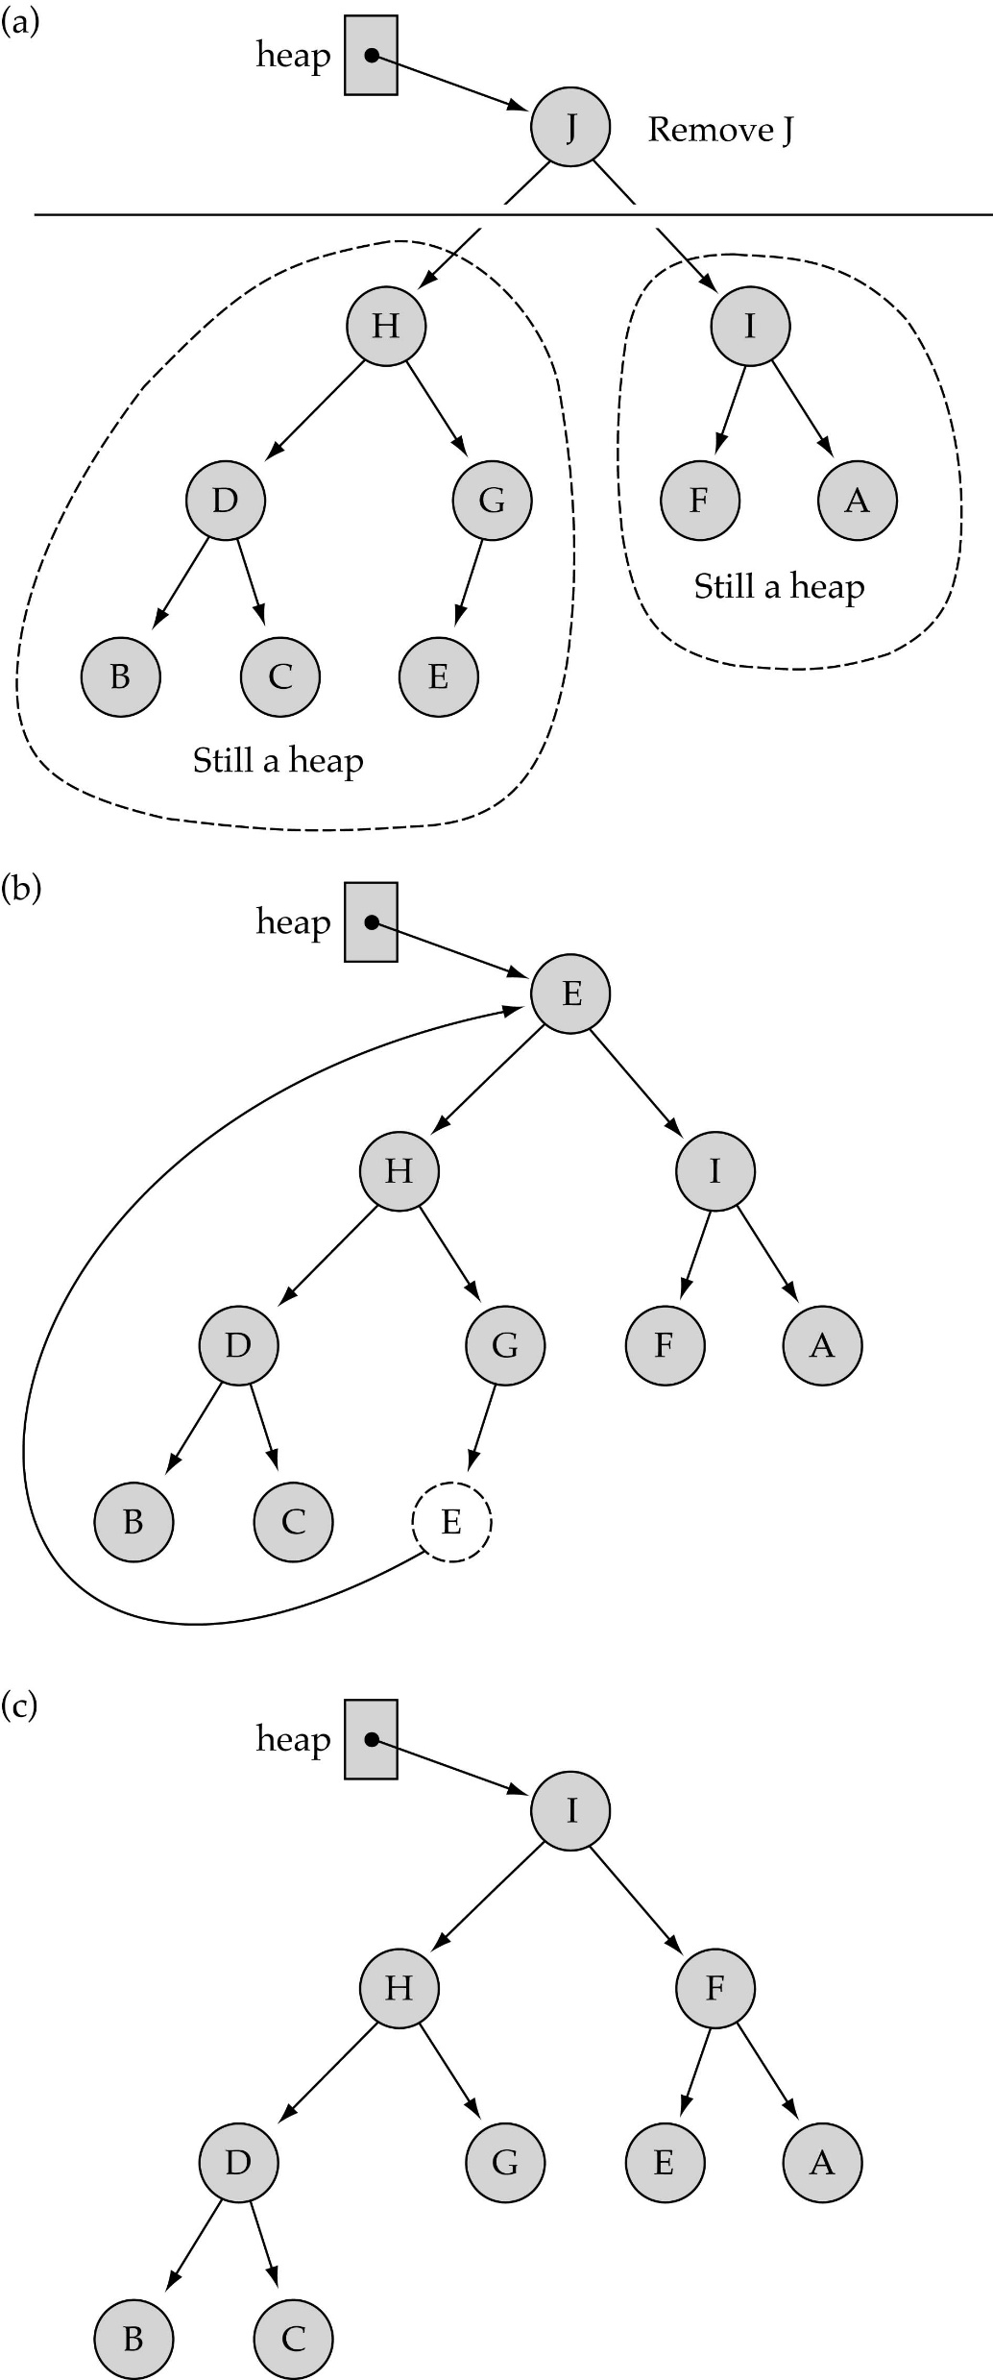
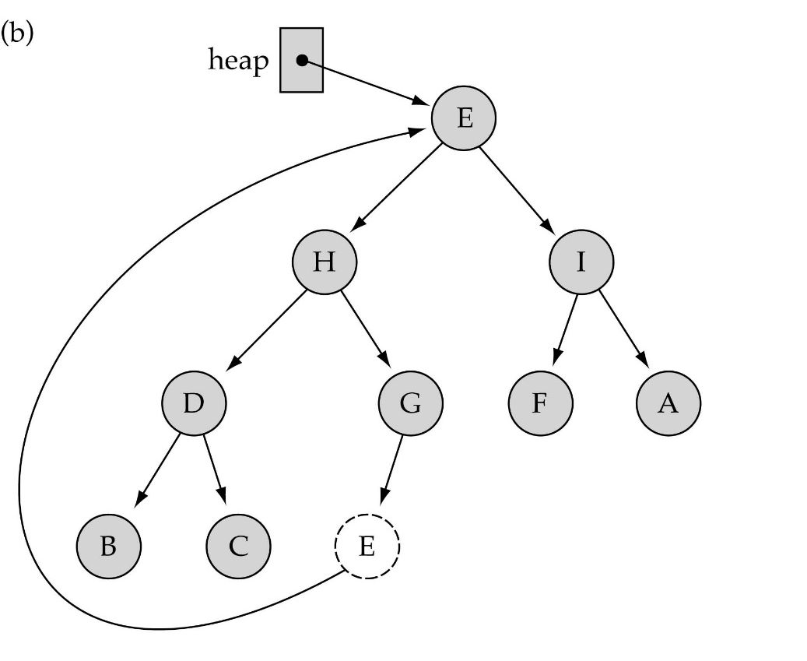
Removing the largest element from the heap (cont.)

Slide 18
Removing the largest element from the heap (cont.)

Slide 19
Inserting a new element into the heap
(1) Insert the new element in the next bottom leftmost place
(2) Fix the heap property by calling ReheapUp

Slide 20
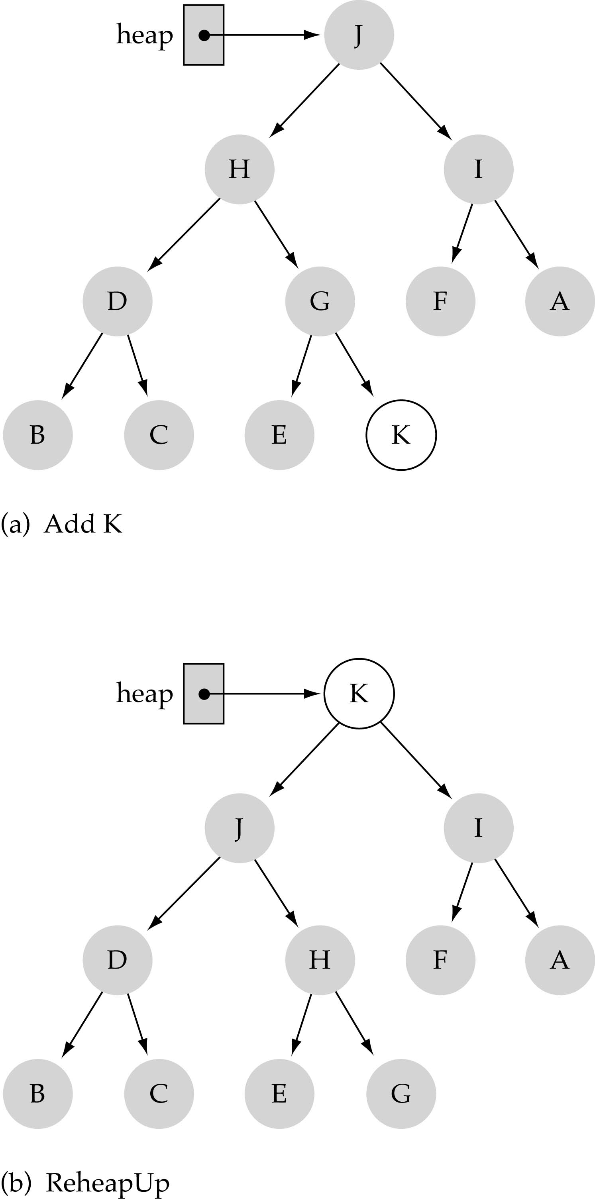
Inserting a new element into the heap (cont.)

Slide 21
Priority Queues
What is a priority queue?
  It is a queue with each element being associated with a "priority"
  From the elements in the queue, the one with the highest priority is dequeued first

Slide 22
Priority queue specification
template<class ItemType>
class PQType {
public:
PQType(int);
~PQType();
void MakeEmpty();
bool IsEmpty() const;
bool IsFull() const;
void Enqueue(ItemType);
void Dequeue(ItemType&);
private:
int numItems; // num of elements in the queue
HeapType<ItemType> heap;
int maxItems; // array size
};

Slide 23
Priority queue implementation
template<class ItemType>
PQType<ItemType>::PQType(int max)
{
maxItems = max;
heap.elements = new ItemType[max];
numItems = 0;
}
template<class ItemType>
PQType<ItemType>::MakeEmpty()
{
numItems = 0;
}
template<class ItemType>
PQType<ItemType>::~PQType()
{
delete [] heap.elements;
}

Slide 24
Priority queue implementation
(cont.)
template<class ItemType>
void PQType<ItemType>::Dequeue(ItemType& item)
{
item = heap.elements[0];
heap.elements[0] = heap.elements[numItems-1];
numItems--;
heap.ReheapDown(0, numItems-1);
}
template<class ItemType>
void PQType<ItemType>::Enqueue(ItemType newItem)
{
numItems++;
heap.elements[numItems-1] = newItem;
heap.ReheapUp(0, numItems-1]);
}
bottom
bottom

Slide 25
Priority queue implementation
(cont.)
template<class ItemType>
bool PQType<ItemType>::IsFull() const
{
return numItems == maxItems;
}
template<class ItemType>
bool PQType<ItemType>::IsEmpty() const
{
return numItems == 0;
}

Slide 26
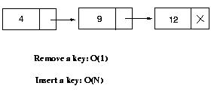
Comparing heaps with other priority queue representations
Priority queue using linked list
12
4
Priority queue using heaps
  - Remove a key in O(logN) time
  - Insert a key in O(logN) time

Slide 27
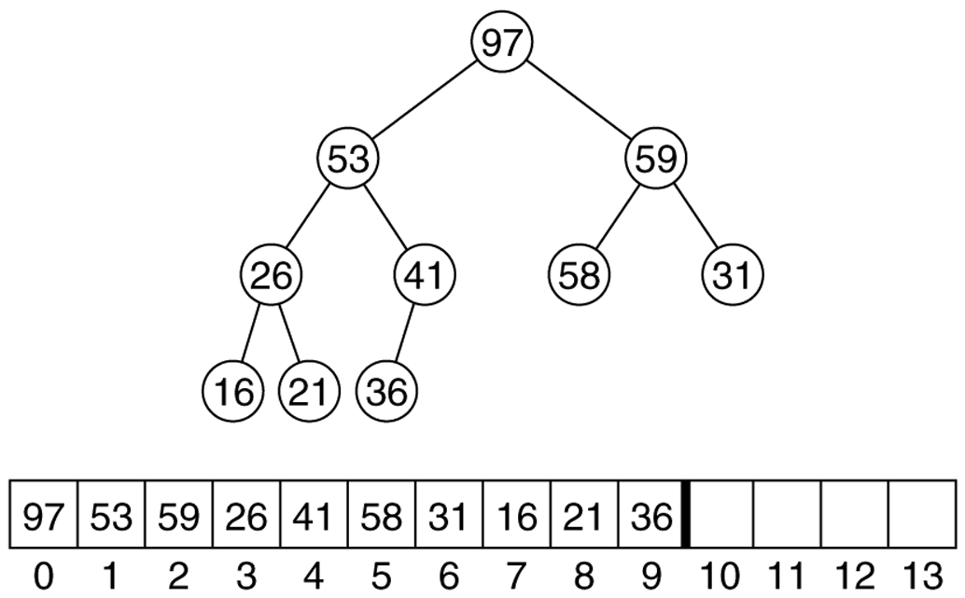
Max heap after the buildHeap phase for the input sequence 59,36,58,21,41,97,31,16,26,53

Slide 28
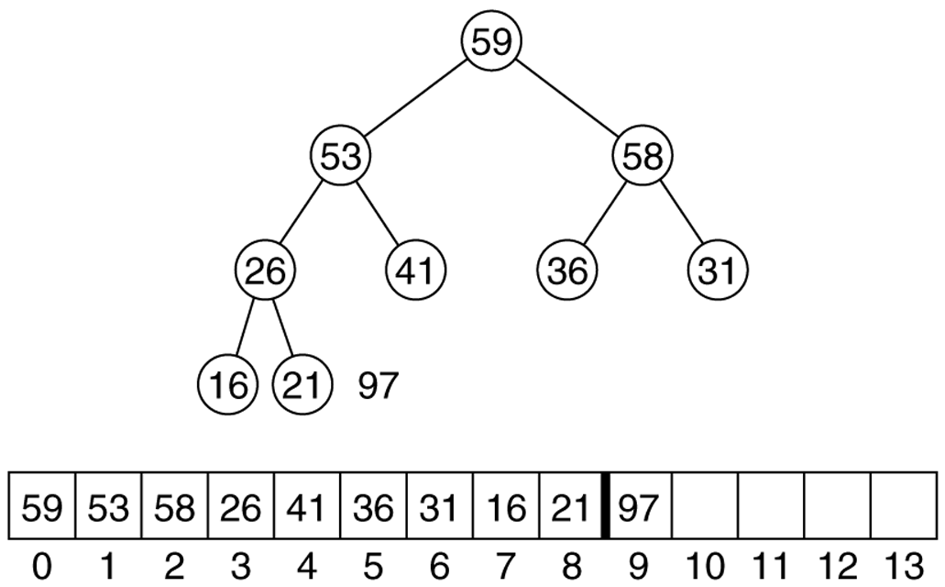
Heap after the first deleteMax operation

Slide 29
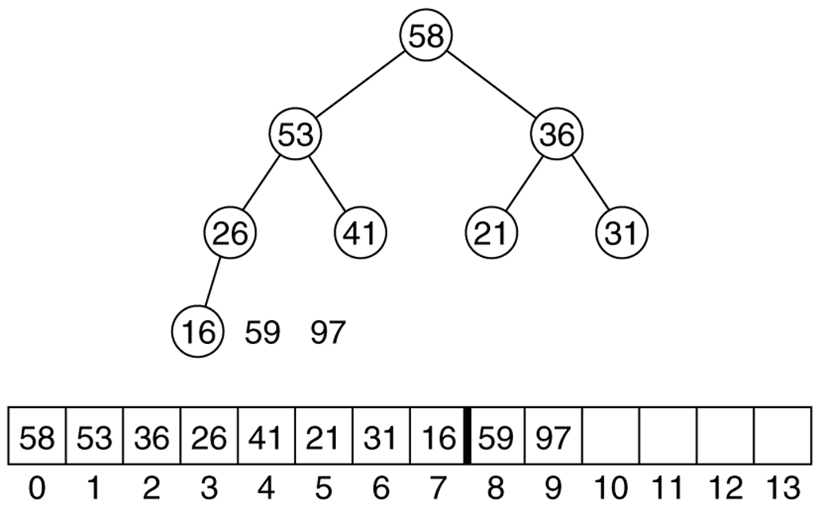
Heap after the second deleteMax operation

